Slide 1

JARVIS: AI Virtual Assistant
Revolutionizing Human-Computer Interaction with Voice-Controlled AI System on Windows
M Haroon Sajid
Arbi AMIr

Slide 2
Problem Statement:
JARVIS AI PERSONAL ASSISTANT can understand and respond to user commands, automate routine tasks, and provide personalized assistance, with a special focus on accessibility for individuals with special needs.”
The key motivations for this project are:
Interest: Our interest to Learning Python, AI, and NLP through building this project. It combines Python programming with hands-on AI and NLP projects, providing a comprehensive learning experience tailored to real-world applications.
Efficiency: Automating routine tasks can save users significant amount of time and effort.
Accessibility: The voice-controlled system can be particularly useful for individuals with special needs who may have difficulty using traditional input methods, such as the keyboard or mouse.
Personalization: By learning from user interactions, the AI assistant can provide a more personalized and intuitive user experience.
Innovation: The project represents an opportunity to explore and apply cutting-edge AI technologies in a practical, real-world context.
In terms of benefits for individuals with special needs, the JARVIS AI Personal Assistant can provide several advantages:
Ease of Use: Voice commands can be easier to use than traditional computer interfaces, especially for individuals with physical disabilities.
Independence: The AI assistant can help users with special needs perform tasks independently, reducing the need for assistance from others.
Customization: The AI assistant can be customized to suit the specific needs and preferences of the user, providing a more personalized experience.
In essence, the JARVIS AI Personal Assistant project is about making technology more accessible and personalized, helping all users, including those with special needs, to interact with their computers in a more natural and intuitive way. 😊

Slide 3
Introduction
Artificial Intelligence helps machines think like humans. With Python, a popular programming language, we can easily create a Voice Assistant. This assistant understands and follows our instructions through speech recognition, similar to Alexa or Siri. Using Python's Speech Recognition API, we can convert spoken words into text.
Creating a Voice Assistant is an enjoyable project. It simplified tasks like image generating, searching on Google, playing music, or even opening software with just a voice command. Today's technology allows machines to perform tasks as effectively as, or even better than, humans, making our lives easier and saving time.
The Voice Assistant, powered by AI, delivers accurate and efficient results. It reduces the need for typing and acts as a helpful companion, completing tasks quickly. While it's like having another person around, it's even more effective and efficient. The libraries and packages used in creating the assistant focus on saving time and simplifying complex tasks.
I have watched some YouTube tutorials about JARVIS and have also read some articles. I plan to learn and implement more knowledge about it while developing this project.

Slide 4
Functionalities of this project include:
1. It can generate code
2. It can generate images.
3. It can read PDF.
4. It can play music.
5. It can change wallpapers.
6. It can give weather forecast.
7. It can do Wikipedia searches for you.
8. It can open command prompt, chrome browser, notepad etc.
9. It can open websites like Google, YouTube, etc., in a web browser.
10. It can have some basic conversation with you.
And much more functions.

Slide 5
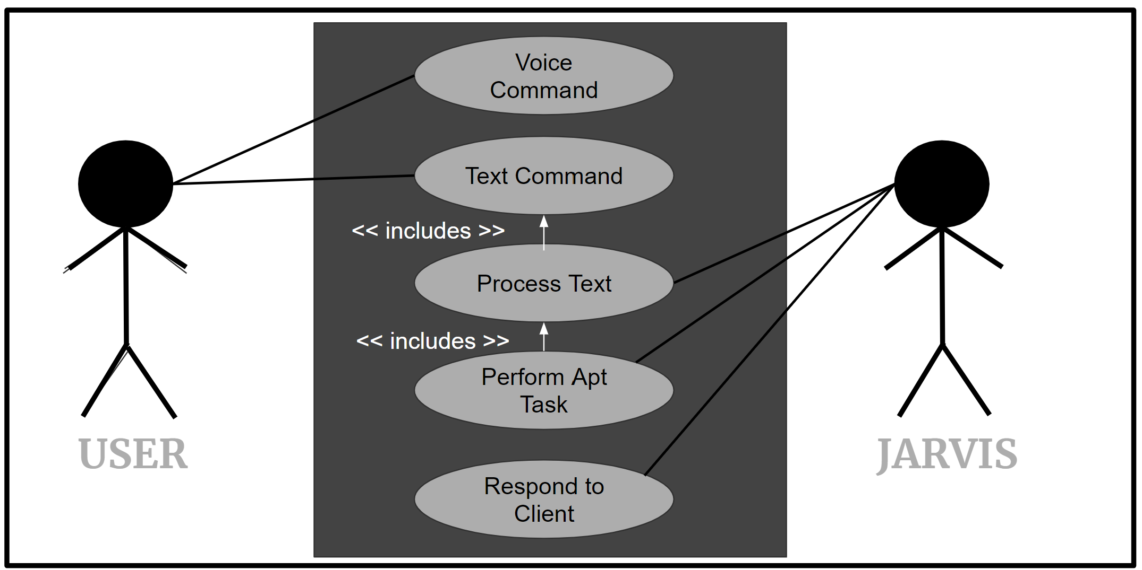
Design Diagram

Slide 6
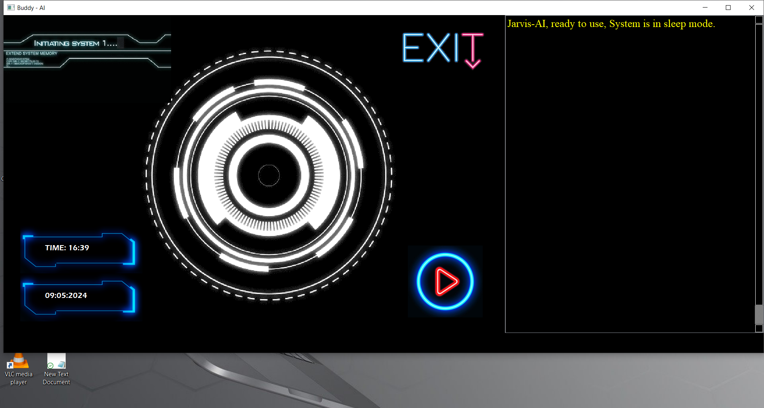
User Interface

Slide 7
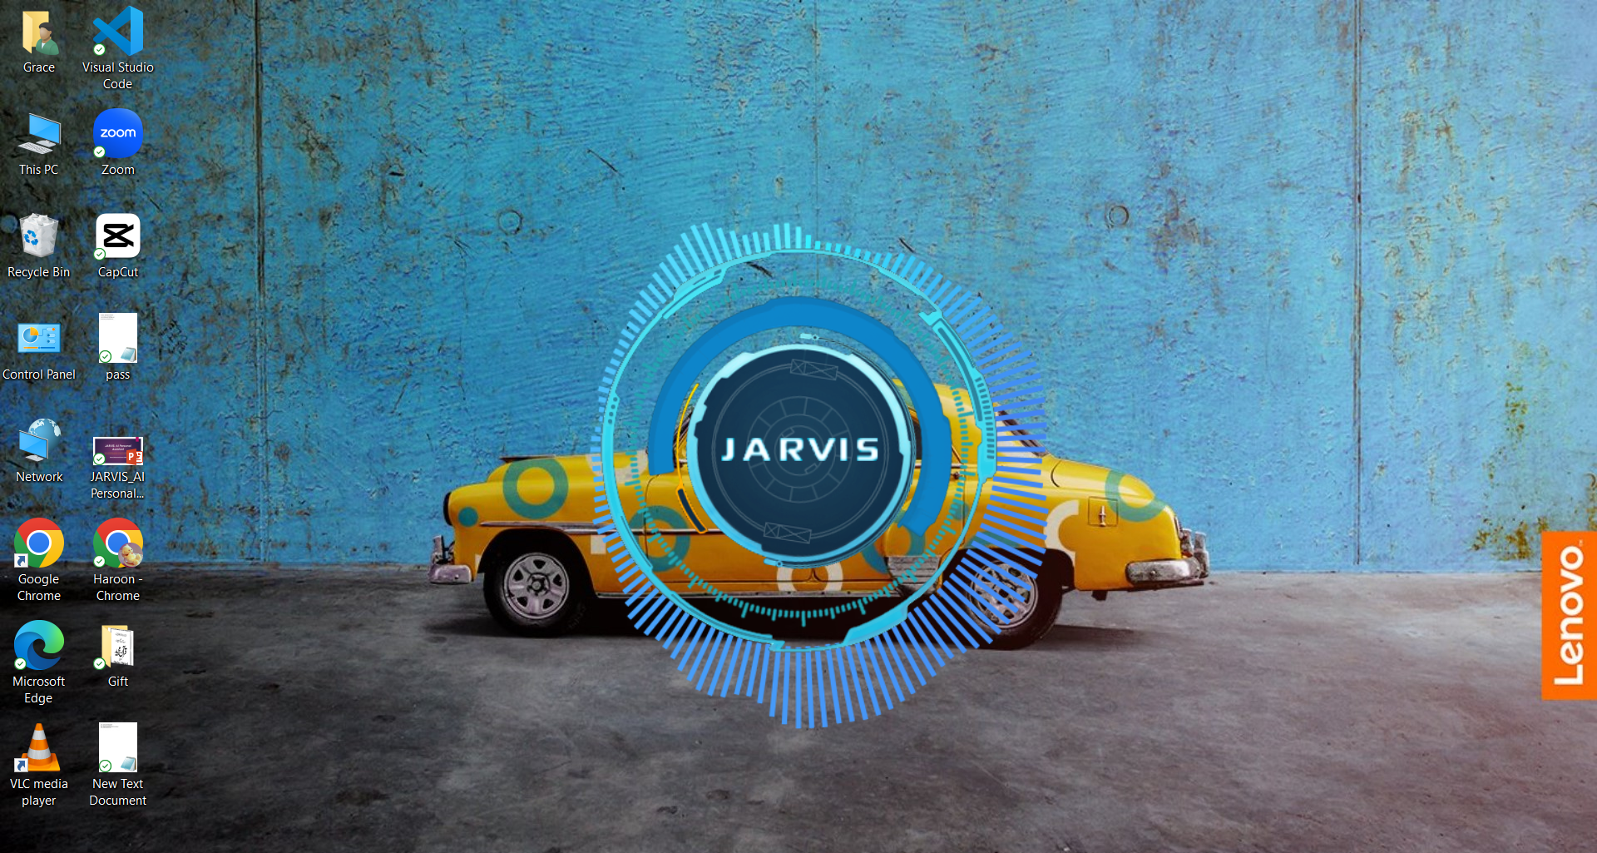
Desktop Interface

Slide 8
PYTHON LIBRARIES
In JARVIS following python libraries were used:
pyttsx3: It is a python library which converts text to speech.
SpeechRecognition: It is a python module which converts speech to text.
Datetime: This library provides us the actual date and time.
Wikipedia: It is a python module for searching anything on Wikipedia.
PyAudio enables you to play audio streams from various sources
PyWhatKit is a versatile library that simplifies various tasks such as sending WhatsApp messages, playing YouTube videos, and retrieving information from the web.

Slide 9
pyPDF2: It is a python module which can read, split, merge any PDF.
Webbrowser: It provides interface for displaying web-based
documents to users.
Pyautogui: It is a python libraries for graphical user interface.
os: It represents Operating System related functionality.
sys: It allows operating on the interpreter as it provides access to the variables and functions that usually interact strongly with the interpreter.
NLTK, short for Natural Language Toolkit, is a powerful library in Python for working with human language data

Slide 10
Functionalities
JARVIS an intelligent personal assistant designed for the Windows operating system, aims to provide users with a versatile and efficient digital companion. The functional requirements outlined below cover a wide range of capabilities, ensuring seamless integration into users' daily tasks.
Image Generation:
JARVIS revolutionizes image generation with intuitive voice and text commands, facilitating effortless creation of diverse imagery, from breathtaking landscapes to different designs.
Code & Poem Generation:
JARVIS is a versatile AI assistant offering code generation for automating tasks and assisting in programming, along with the ability to craft original poems based on prompts, fostering creativity. It can help you write code to automate tasks and make programming easier. And if you give it a topic, it can create its own poems, which is great for sparking your creativity.

Slide 11
Functionalities
Dictionary:
JARVIS will provide comprehensive dictionary services, assisting users in understanding the meanings and synonyms of words.
Check battery:
The "Check battery" function serves as a crucial utility, providing users with real-time information about their device's battery status.
Application Execution:
JARVIS will promptly execute system commands to open and close applications such as the command prompt, notepad, system info, settings and other specified applications. This feature ensures instant access to essential tools based on user preferences.
Music Playback:
Users can enjoy music playback through JARVIS, which will access and play music from the user's library or online sources. The assistant will respond to voice commands, enabling users to effortlessly control playback, adjust volume, select playlists, and explore new music.

Slide 12
Functionalities
Information Retrieval:
JARVIS will conduct Wikipedia searches, scrape online data from various sources, and retrieve information from the internet, providing users with quick access to relevant information.
Weather Forecasts:
JARVIS will offer current weather forecasts based on user location or specified locations. Users can inquire about weather conditions through natural language commands, enhancing daily planning and decision-making.
Latest News:
JARVIS will extract the latest news from various reliable sources and deliver it to the user through natural speech synthesis. Using advanced algorithms, JARVIS will speak headlines and summaries to the user's preferences, ensuring relevance and accuracy. Whether it's breaking news, Tech updates, or trending topics. This feature enhances the overall functionality of the JARVIS project, improve user interaction and keeping them informed in real-time.
Conversational Interactions:
To enhance the overall user experience, JARVIS will engage in basic conversational interactions. Users can ask questions, seek assistance, or simply enjoy casual conversations with the AI assistant, creating a more natural and user-friendly interaction model.

Slide 13
LIMITATIONS
Security is somewhere an issue, there is no voice command encryption in this project.
Background voice can interfere
Misinterpretation because of accents and may cause inaccurate results.
JARVIS cannot be called externally anytime like other traditional assistants like Google Assistant can be called just by saying, “Ok Google!”

Slide 14
SCOPE FOR FUTURE WORK
Make JARVIS to learn more on its own and develop a new skill in it.
JARVIS android app can also be developed.
Integrate JARVIS with smart home devices for automated control.
Implement natural language processing for improved understanding.
Integrate data analysis and data visualization functionalities in JARVIS
Implement sentiment analysis to display user emotions and adjust responses accordingly.

Slide 15


